Slide 1
Css And CSS 3
SlideMake.com

Slide 2
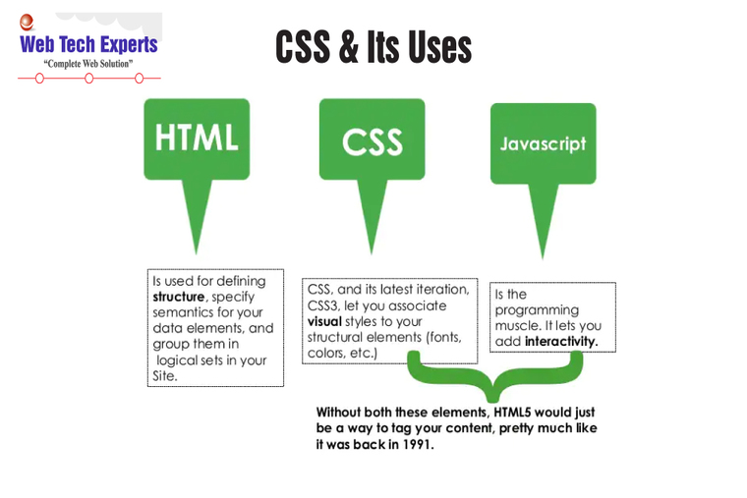
Introduction to CSS
CSS stands for Cascading Style Sheets.
It is used for styling web pages and controlling their layout.
CSS separates the content of a webpage from its design.
Notes:
Image source: https://www.webtechexperts.in/update/introduction-to-cascading-style-sheets-css

Slide 3
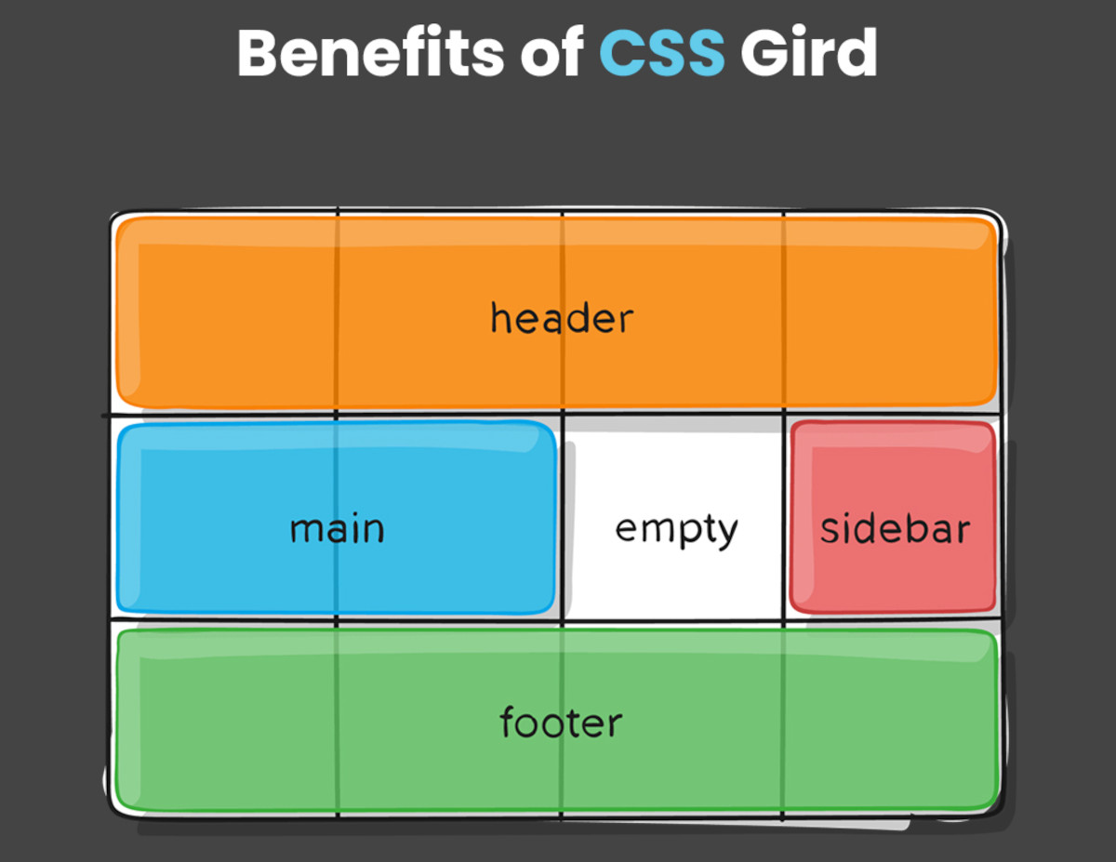
Benefits of CSS
CSS allows for consistent styling across multiple pages.
It enhances the user experience by improving page load times.
With CSS, web developers can easily make global changes to a website's design.
Notes:
Image source: https://www.geekboots.com/story/css-grid-and-its-benefits

Slide 4
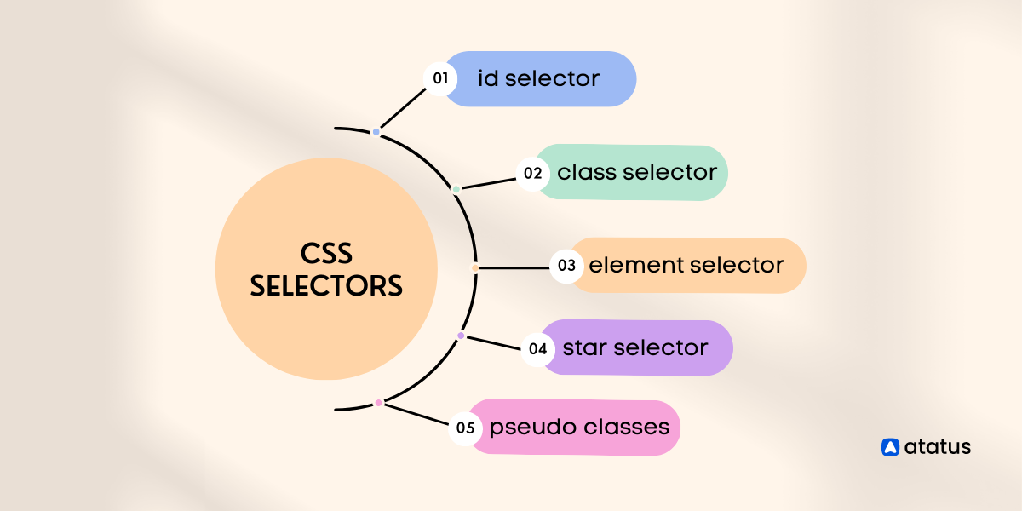
Selectors in CSS
CSS selectors are used to target specific HTML elements for styling.
Examples of selectors include class, ID, element, and attribute selectors.
Selectors help apply styles to specific parts of a webpage.
Notes:
Image source: https://www.atatus.com/blog/powerful-css-selectors/

Slide 5
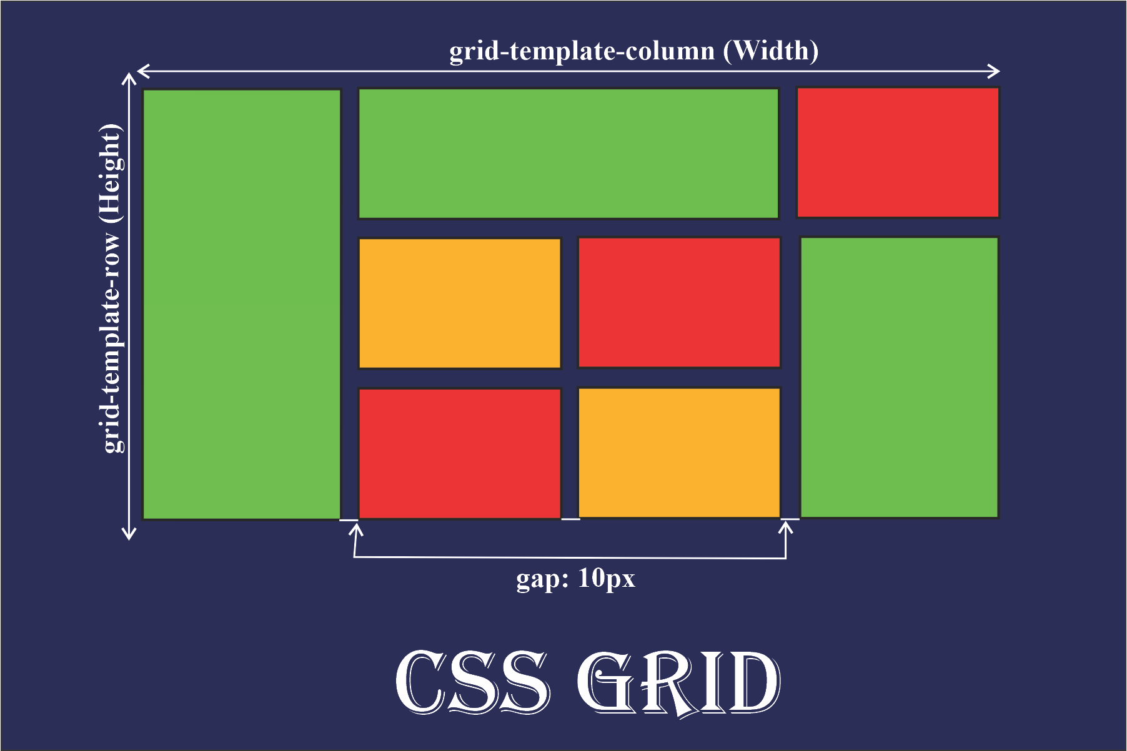
CSS Properties and Values
CSS properties control various aspects of an element's style, such as color, size, and layout.
Values define how the properties should be applied, like specifying a specific color or font size.
Understanding different properties and values is key to creating visually appealing websites.
Notes:
Image source: https://old.sermitsiaq.ag/en/grid-template-rows-css.html

Slide 6
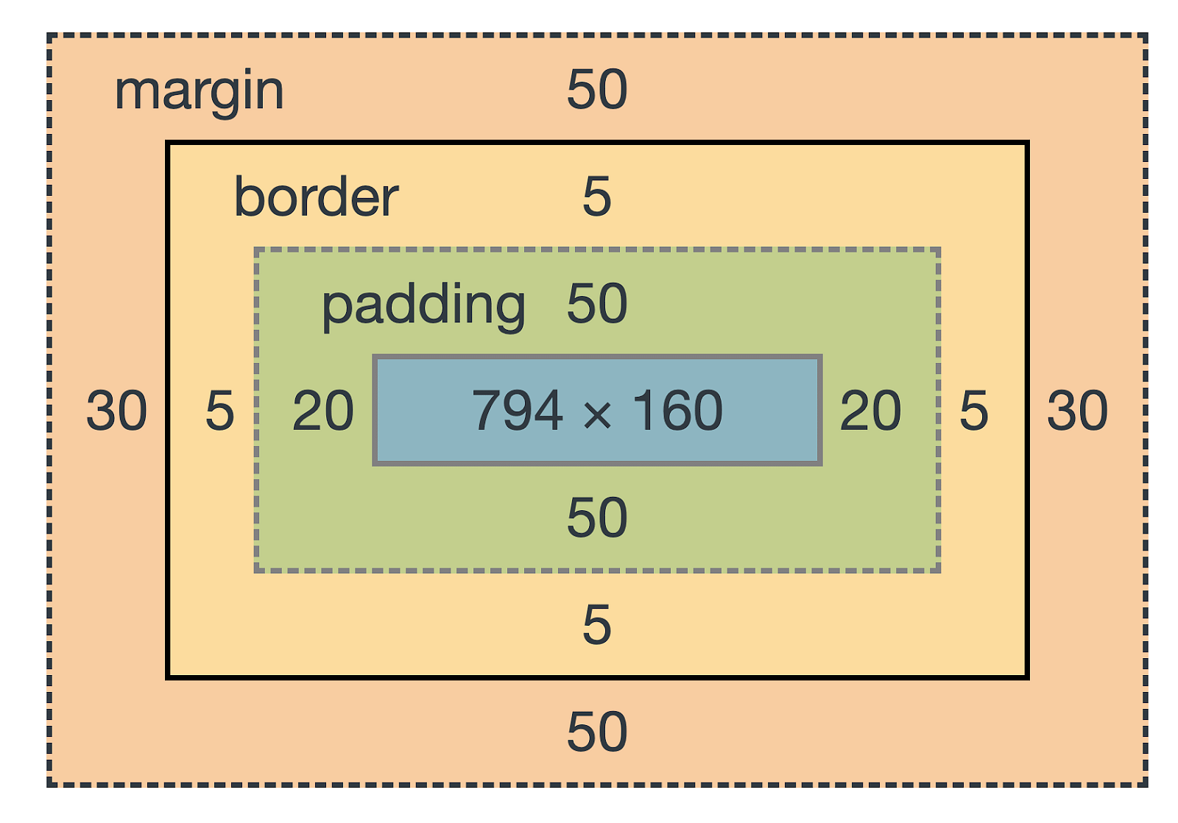
CSS Box Model
The CSS box model defines the spacing and layout of elements on a webpage.
It consists of content, padding, border, and margin.
Understanding the box model helps in creating responsive and well-structured layouts.
Notes:
Image source: https://www.simplilearn.com.cach3.com/tutorials/css-tutorial/css-box-model.html

Slide 7
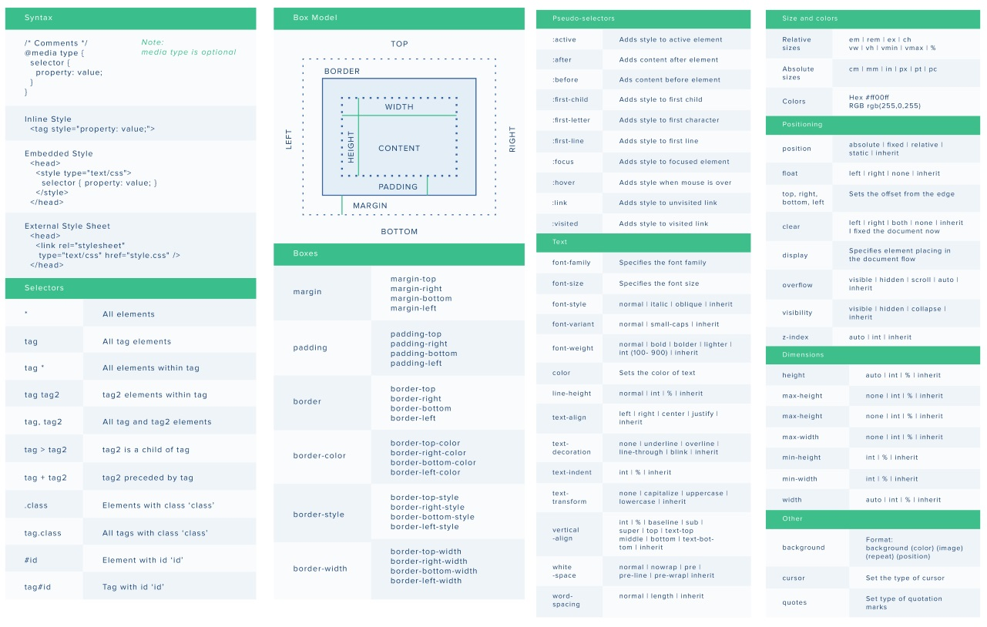
CSS3 Features
CSS3 introduced new features like rounded corners, shadows, gradients, and animations.
It improved the capabilities of CSS for creating modern and interactive web designs.
CSS3 brought about significant advancements in web styling techniques.
Notes:
Image source: http://alansimpson.me/html_css/infographics/csscomplete/

Slide 8
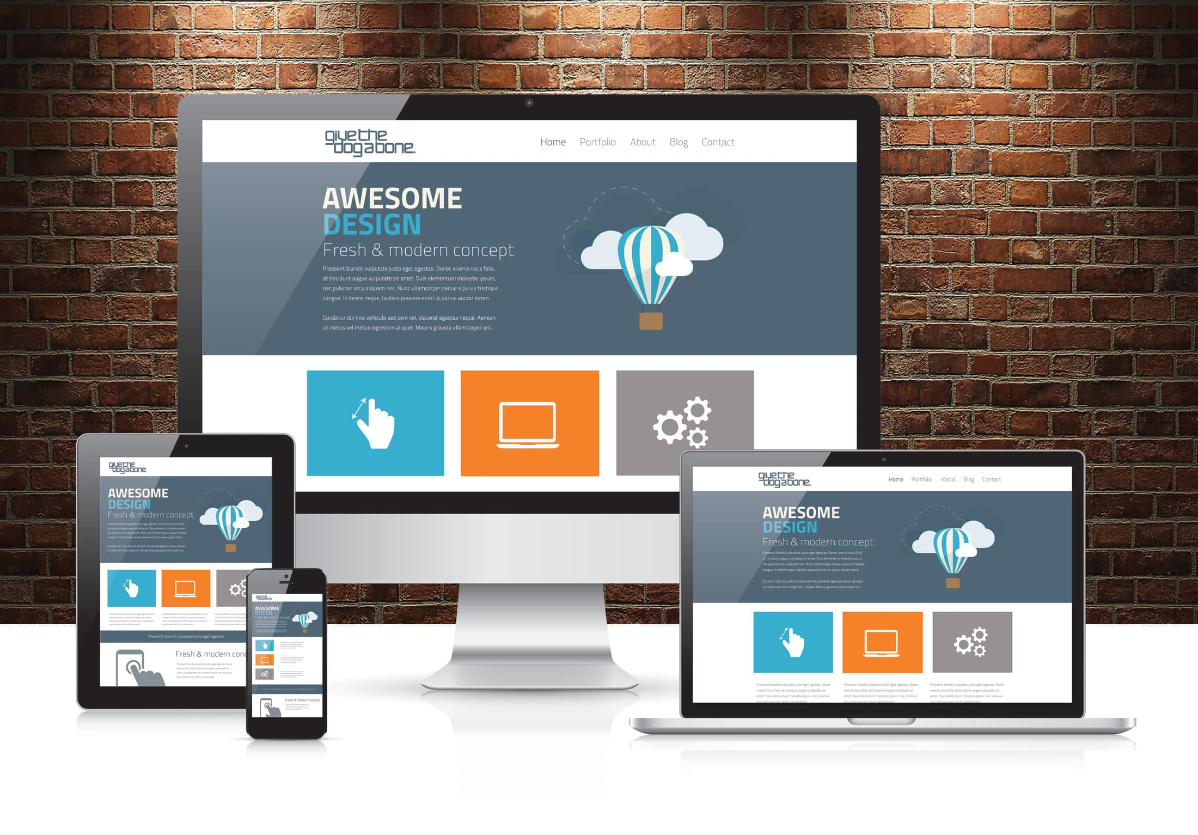
Responsive Design with CSS
CSS allows for creating responsive websites that adapt to different screen sizes.
Media queries in CSS help adjust styles based on the device's screen resolution.
Responsive design is essential for providing a seamless user experience across various devices.
Notes:
Image source: https://www.givethedogabone.com/blog/responsive-web-design-explained/

Slide 9
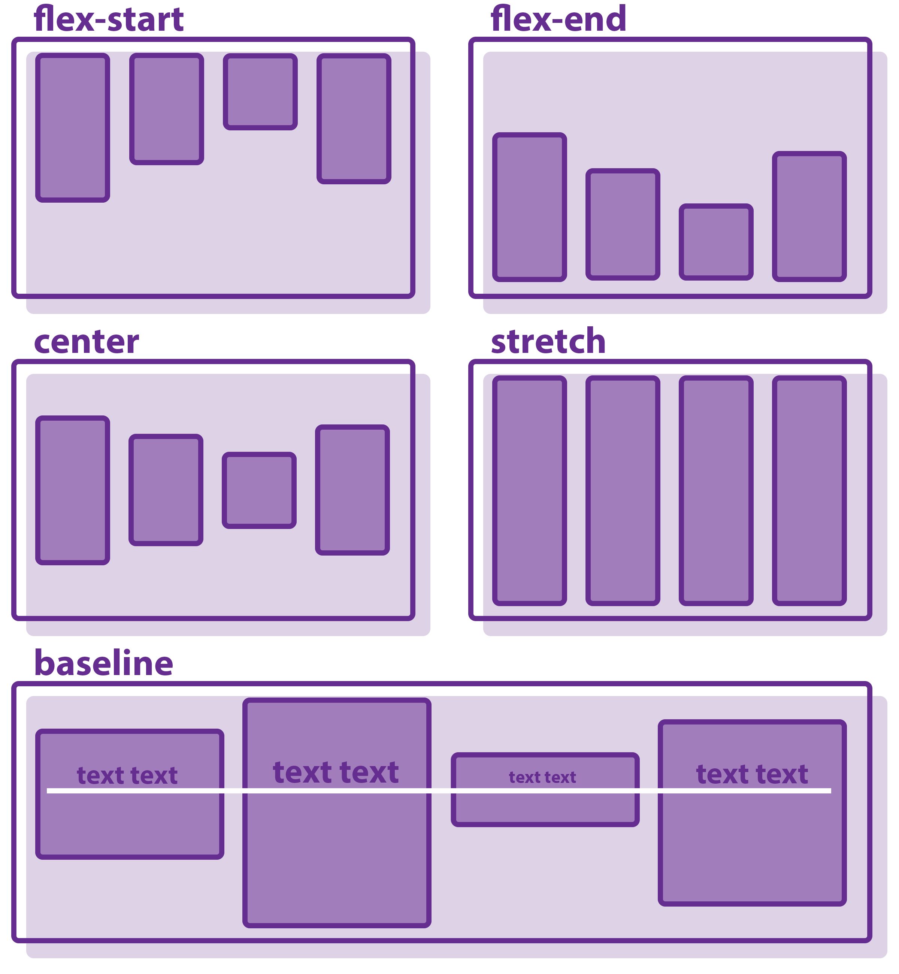
Flexbox in CSS3
Flexbox is a layout model in CSS3 that allows for designing flexible and efficient layouts.
It simplifies the alignment and distribution of elements within a container.
Flexbox is widely used for creating complex and responsive layouts.
Notes:
Image source: https://www.aiophotoz.com/photos/responsive-gallery-using-css-flex-flexbox-easy-html-and-css-tutorial.html

Slide 10
CSS Grid Layout
CSS Grid Layout is a two-dimensional layout system for designing grid-based layouts.
It offers precise control over the placement of elements on a webpage.
CSS Grid Layout is ideal for creating complex and multi-column layouts.
Notes:
Image source: https://www.freecodecamp.org/news/how-to-use-css-grid-layout/

Slide 11

Transitions and Animations in CSS
CSS transitions and animations allow for adding dynamic effects to web elements.
Transitions enable smooth changes in element properties over a specified duration.
Animations provide more complex and customizable effects for enhancing user engagement.
Notes:
Image source: https://www.pinterest.com/pin/522417625527948880/

Slide 12
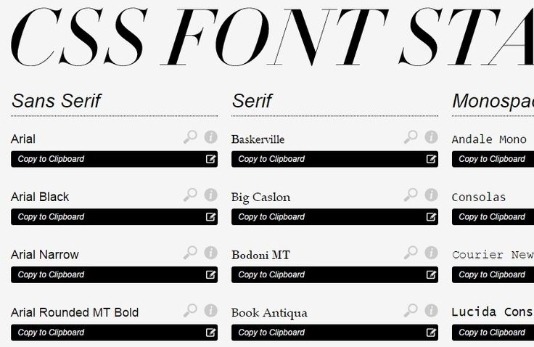
Custom Fonts in CSS
CSS allows for specifying custom fonts to enhance the typography of a webpage.
Web fonts can be embedded or linked from external sources using CSS.
Custom fonts help in creating unique and visually appealing designs.
Notes:
Image source: https://www.pinterest.com/pin/338051515755475327/

Slide 13
CSS Preprocessors
CSS preprocessors like SASS and LESS extend the functionality of CSS by adding features like variables and mixins.
They provide a more efficient way to write and organize CSS code.
Using preprocessors can streamline the development process and make styling easier to maintain.
Notes:
Image source: https://medium.com/@ipenywis/css-preprocessors-getting-started-sass-and-less-practical-examples-68bb4a5fd86e

Slide 14

Cross-Browser Compatibility in CSS
Ensuring cross-browser compatibility is crucial for a consistent user experience across different browsers.
Testing CSS styles on multiple browsers helps identify and resolve any styling inconsistencies.
Using vendor prefixes and modern CSS features can help address compatibility issues.
Notes:
Image source: https://www.riset.guru.pubiway.com/cross-browser-compatibility-testing-checklist-professionalqa-com/

Slide 15
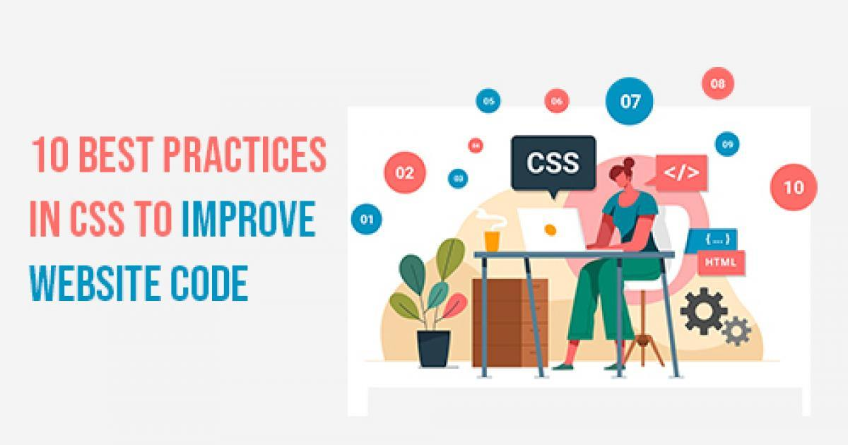
Best Practices in CSS
Organizing CSS code into separate files and folders improves readability and maintainability.
Using meaningful class names and comments in CSS code enhances code understanding.
Following a consistent naming convention like BEM (Block Element Modifier) can streamline styling workflows.
Notes:
Image source: https://www.innoraft.com/blogs/10-best-practices-css-improve-website-code

Slide 16

Performance Optimization in CSS
Minifying CSS files by removing unnecessary spaces and comments can improve page load times.
Combining multiple CSS files into one reduces the number of HTTP requests.
Using CSS sprites for combining images can help reduce the overall page size and enhance performance.
Notes:
Image source: https://toolsa2z.com/blogs/minifying-css-improve-website-performance/

Slide 17

Accessibility in CSS
Ensuring that CSS styles are accessible to all users, including those with disabilities, is essential.
Using semantic HTML elements and providing alternative text for images improves accessibility.
Testing websites with screen readers and keyboard navigation helps ensure a positive user experience for all users.
Notes:
Image source: https://epicassist.org/digital-accessibility-benefits-everyone/

Slide 18
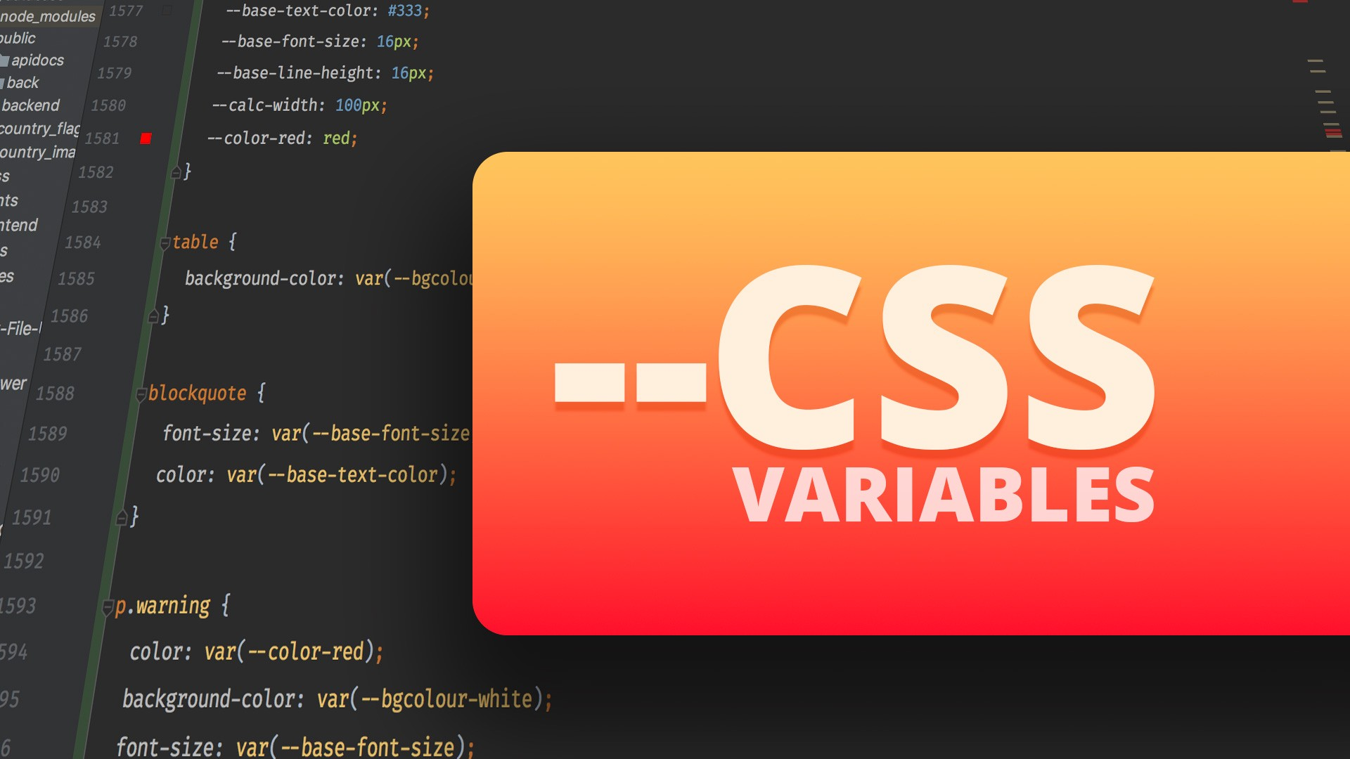
Future Trends in CSS
CSS is constantly evolving, with new features and capabilities being developed.
Features like CSS Variables and Custom Properties are gaining popularity for creating more dynamic styles.
Keeping up with the latest trends and advancements in CSS is essential for staying competitive in web design.
Notes:
Image source: https://nirajanbasnet.com.np/blog/understanding-css-variables/

Slide 19
CSS Frameworks
CSS frameworks like Bootstrap and Foundation provide pre-built components and styles for rapid web development.
They offer a consistent grid system, typography, and UI components that can be customized as needed.
Using CSS frameworks can speed up the development process and ensure a responsive and visually appealing design.
Notes:
Image source: https://www.linkedin.com/pulse/css-framework-showdown-bootstrap-vs-foundation-tailwind-umair-tahir

Slide 20
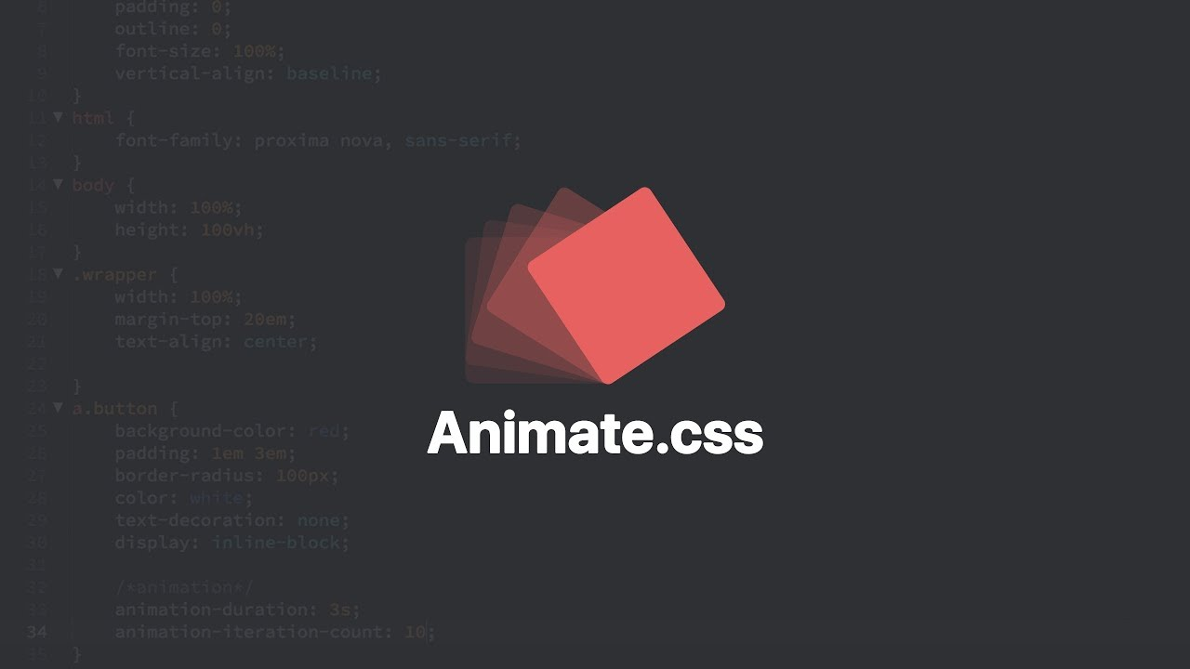
CSS Libraries and Tools
CSS libraries like Animate.css and Hover.css provide ready-to-use animations and effects.
Tools like CSSLint and PostCSS help in linting, optimizing, and extending CSS code.
Leveraging CSS libraries and tools can enhance the styling capabilities and efficiency of web development projects.
Notes:
Image source: https://eletunkbyanyita.blogspot.com/2021/01/tutorial-animate-css-tutorial-easy-css.html

Slide 21
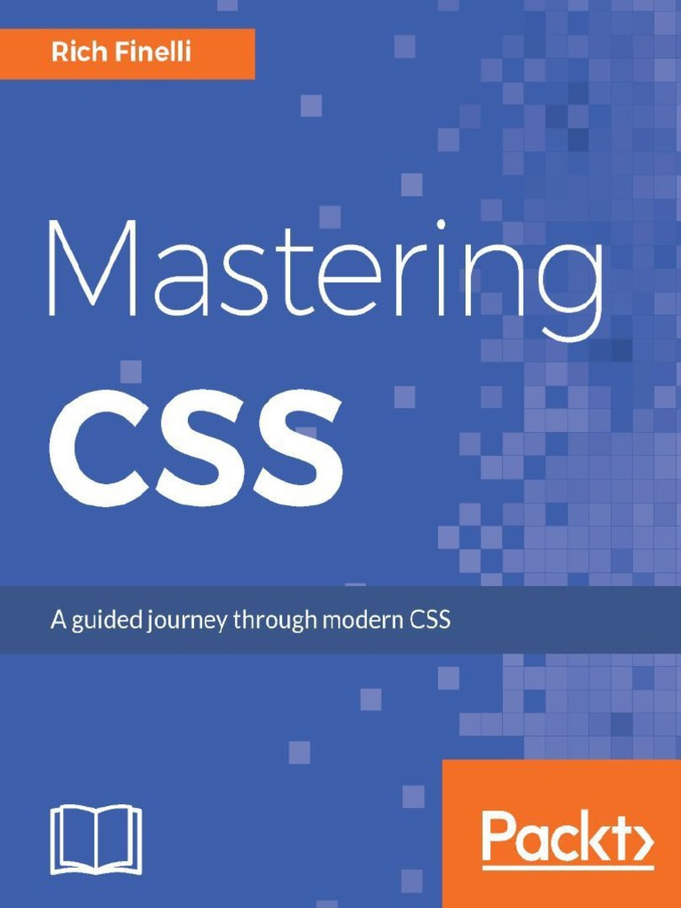
Conclusion
CSS is a fundamental technology for styling and designing modern websites.
CSS3 introduced advanced features that have revolutionized web design capabilities.
Mastering CSS and staying updated on the latest trends is essential for creating engaging and accessible web experiences.
Notes:
Image source: https://www.scribd.com/document/362195463/Mastering-Css-Guide-Modern-Css

Slide 22
References
"CSS: The Definitive Guide" by Eric A. Meyer and Estelle Weyl.
"CSS Secrets: Better Solutions to Everyday Web Design Problems" by Lea Verou.
"CSS Grid Layout: The Ultimate Guide" by Manuel Matuzovic.

